Slide 1
Lecture 01
Introduction

Slide 4
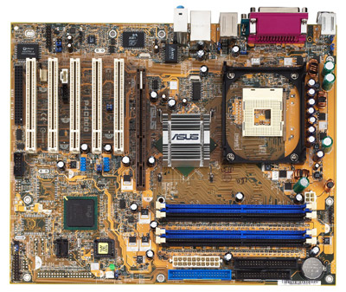
Mother Board

Slide 5
Structure - Top Level
Peripherals
Computer
Central
Processing
Unit
Main
Memory
Computer
Systems
Interconnection
Input
Output
Communication
lines

Slide 6
Computer:
Central processing unit:
controls the operation of the computer and perform its data processing functions; also called processor
Main memory:
stores data temporarily
I/O:
Moves data between computer and its external environment.
System interconnection:
Mechanism that provides for communication among CPU, main memory and I/O

Slide 7
Structure - The CPU
CPU
Computer
Arithmetic
and
Login Unit
I/O
Registers
System
Bus
CPU
Internal CPU
Interconnection
Memory
Control
Unit

Slide 8
CPU
Control Unit:
controls the operation of the CPU and hence the computer
Arithmetic and logic Unit (ALU):
Performs computers data processing functions
Registers:
Provides storage internal to the CPU
CPU interconnection:
Mechanism that provides for communication among the control unit, ALU, and registers.

Slide 9
Structure - The Control Unit
Control Unit
CPU
ALU
Sequencing
Logic
Internal
Bus
Control
Unit
Control Unit
Registers and
Decoders
Registers
Control
Memory

Slide 10
Control Unit
Control memory:
store control signal selection and sequencing information
Control unit registers and decoders:
detects and executes the microinstruction
Sequencing logic:
sets the logic to execute next microinstruction.

Slide 11
Microprocessor vs. Microcomputer
Microprocessor – A processor unit typically with only basic I/O interface, off-chip memory.
e.g.: Intel 8008, 8080, 8086, 80286, Pentium
Single-chip Microcomputer – A processor unit with on-chip memory, I/O devices, and often other peripheral devices such as timers and A to D.
e.g.: Intel 8048, 8051, Motorola 68HC11/12

Slide 12
Microcontroller
An I/O oriented single-chip microcomputer
Microcontroller vs other single-chip microcomputers:
Extended I/O capabilities
  Synchronous and asynchronous communication devices, A/D and D/A converters, timers, counters, watchdogs.
Interrupt Handling
  Increased ability to prioritize levels of interrupts and mask individual interrupts.
Instruction Set
  Instructions oriented toward bit manipulation, operations on single bits of memory words or I/O ports.

Slide 13
Microcontroller Applications
Cars
  Engine fuel injection
  Transmission control
  Suspension and ride control
  Instrument display
  Braking system
Home Appliances
  Washing machine
  Microwave oven
  Refrigerator
Sports Equipment
  Exercise Machine
  Heart Rate Monitor

Slide 14
Microcontroller Applications
Consumer Electronics
  Digital/Film cameras
  Televisions
  CD players
  Telephone
Computer Peripherals
  Printers
  Scanners
  Disk drive controllers
  Wireless desktop
Robots

